Slide 1

Bank Network
Infrastructure Design & Implementation

Slide 2


Contents
Our Team
Project Overview
Project Phases
- Network Modelling
- Network Topology Design
- Routers & Multi-Layer Switches Configuration
- Access Switches Configuration
- End-Points Configuration
- Project Testing
Summary
Questions

Slide 3






OUR TEAM
Shahd Alaa El-Din Mostafa
Mohamed Mahmoud Ramadan
Mohamed Al-Tantawy Yehya
Mohamed Mahmoud Al-Sayed
Mohamed Nasser
El-Desouky
Youssef Abdelnasser Ramadan

Slide 4




Project Overview
The network design project aims to create a reliable, scalable, and secure network infrastructure for a multi-story bank building. The network supports various departments across four floors, each with its own set of services and devices. The design incorporates high availability, efficient traffic management, and secure access for both wired and wireless devices.

Slide 5
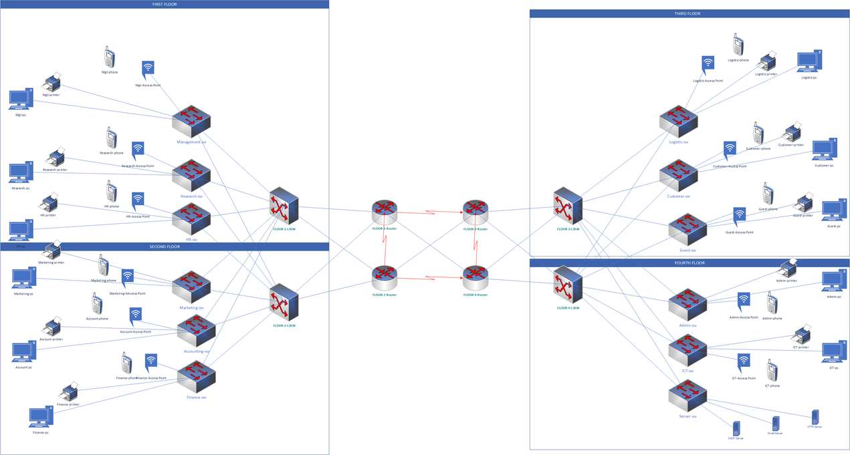
Project Phases
1- Network Modelling
In this Phase we have created a model for network infrastructure that shows network features using (Microsoft Visio) as a modelling tool.

Slide 6
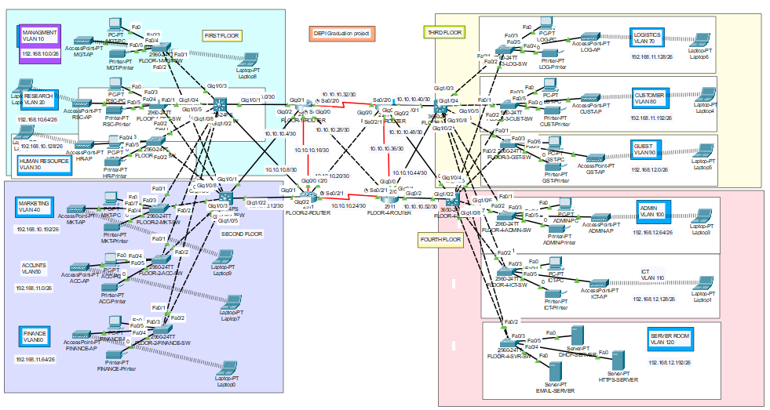
Project Phases
2- Network Topology Design
In this Phase we have created a structured layout of the bank's network infrastructure. This includes defining the logical and physical layout of the network components, such as routers, multilayer switches, access points, servers, and end-user devices.

Slide 7
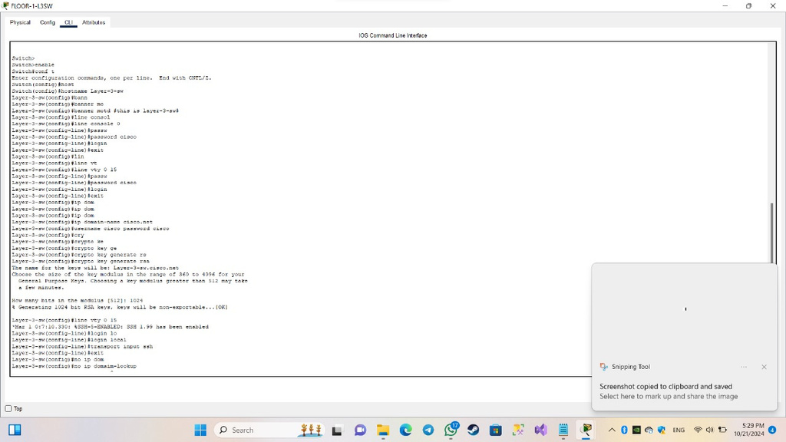
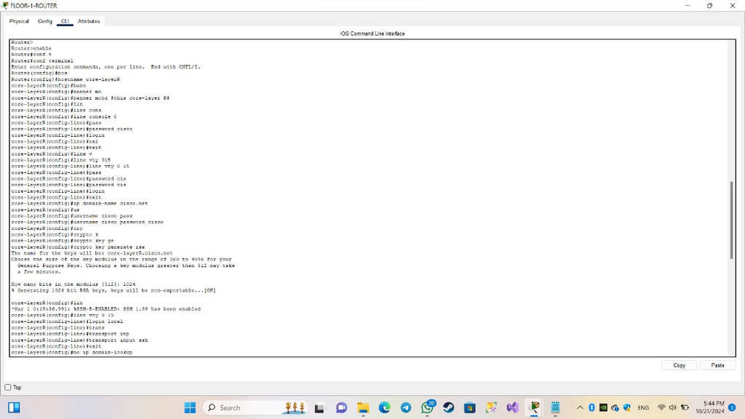
Project Phases
3- Routers & Multi-Layer Switches Configuration
In this phase we set up devices for routing and advanced switching. This includes configuring routing protocols, inter-VLAN routing, and security features to enable communication between different network segments securely and efficiently.

Slide 8
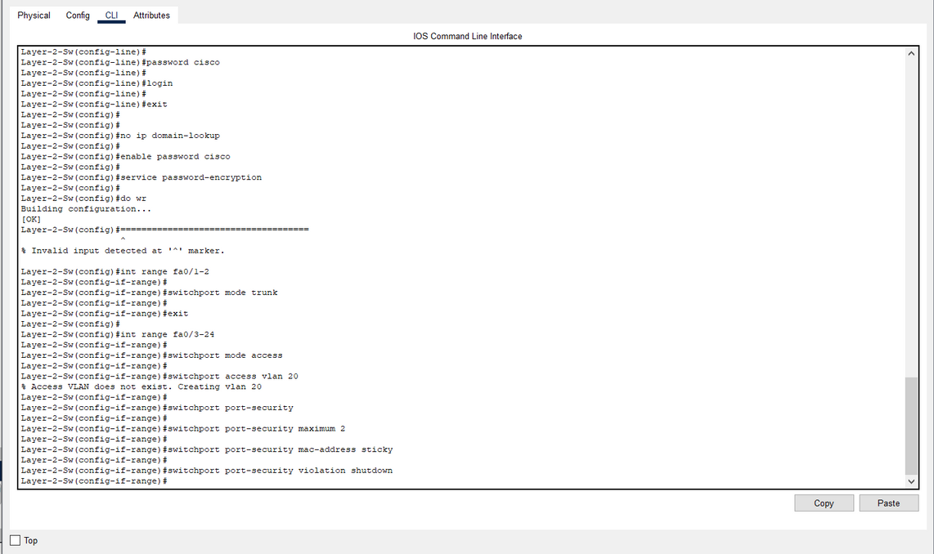
Project Phases
4- Access Switches Configuration
In this phase ,we sets up switches to connect user devices to the network. It includes VLAN setup, port security, and basic settings to ensure secure and efficient device connections.

Slide 9
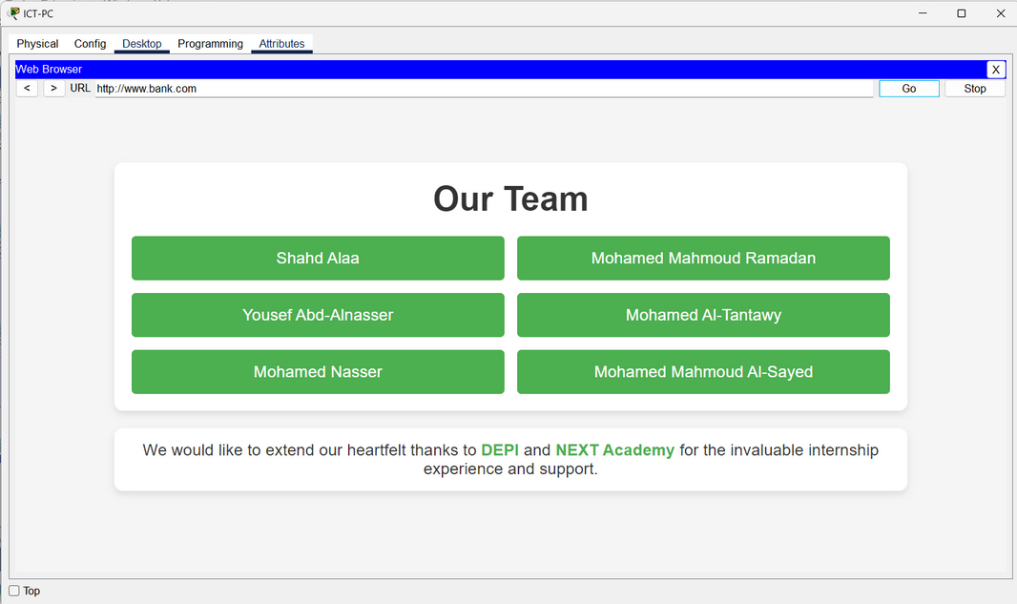
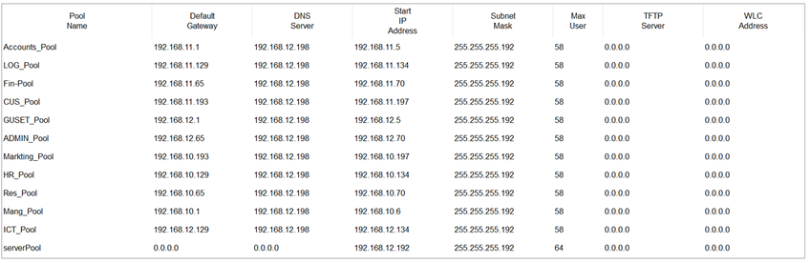
Project Phases
5- End-Points Configuration
In this phase, we set up devices like computers and printers in a network. It includes assigning IP addresses, configuring DNS servers, setting up the default gateway, and implementing security settings. These configurations ensure proper connectivity and communication within the network.

Slide 10
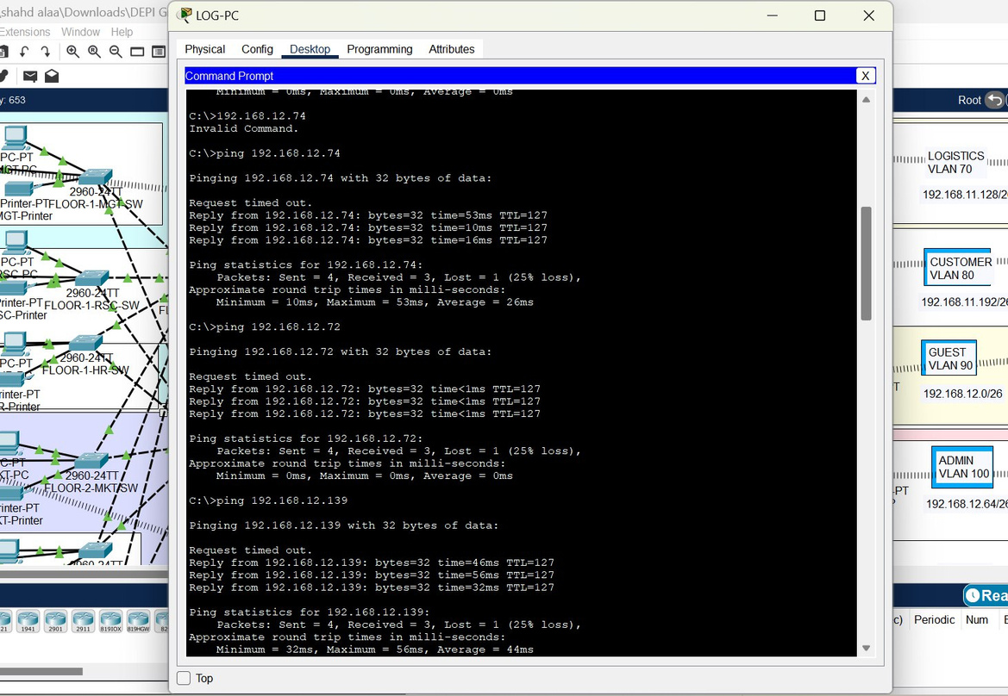
Project Phases
6- Project Testing
In this phase we verified the network's functionality, connectivity, performance, and security. Testing ensures all devices communicate correctly, configurations are accurate, and the network meets performance and security standards before deployment.

Slide 11

Summary
This network infrastructure setup provides a highly scalable, secure, and efficient solution tailored to the bank's needs. It combines advanced routing, secure wireless communication, and robust security measures to protect the integrity and availability of the network.

Slide 12

Any Questions?

Slide 13
Thank You

